Slide 1
Выполнила: Самсонова Е.Л.
Учитель МОУ Зюзинская ООШ

Slide 2
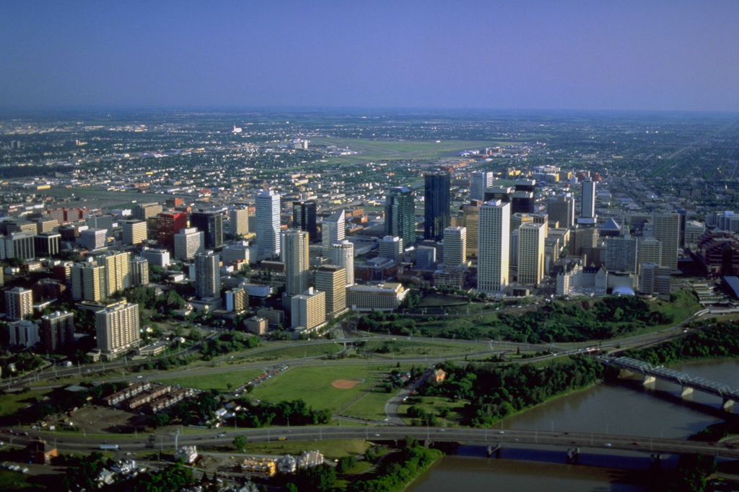
What makes Canada so great? Too many things to mention here, but they do include its people, languages, vastly different environment, crazy weather and much more! Here is a bit of information.

Slide 3
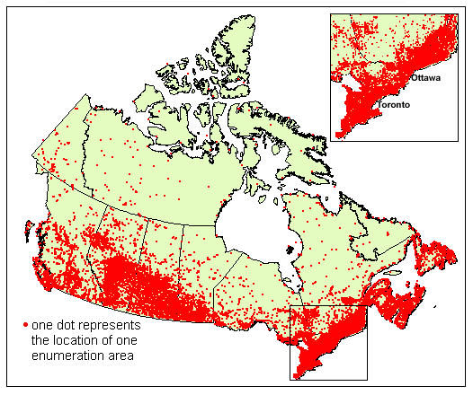
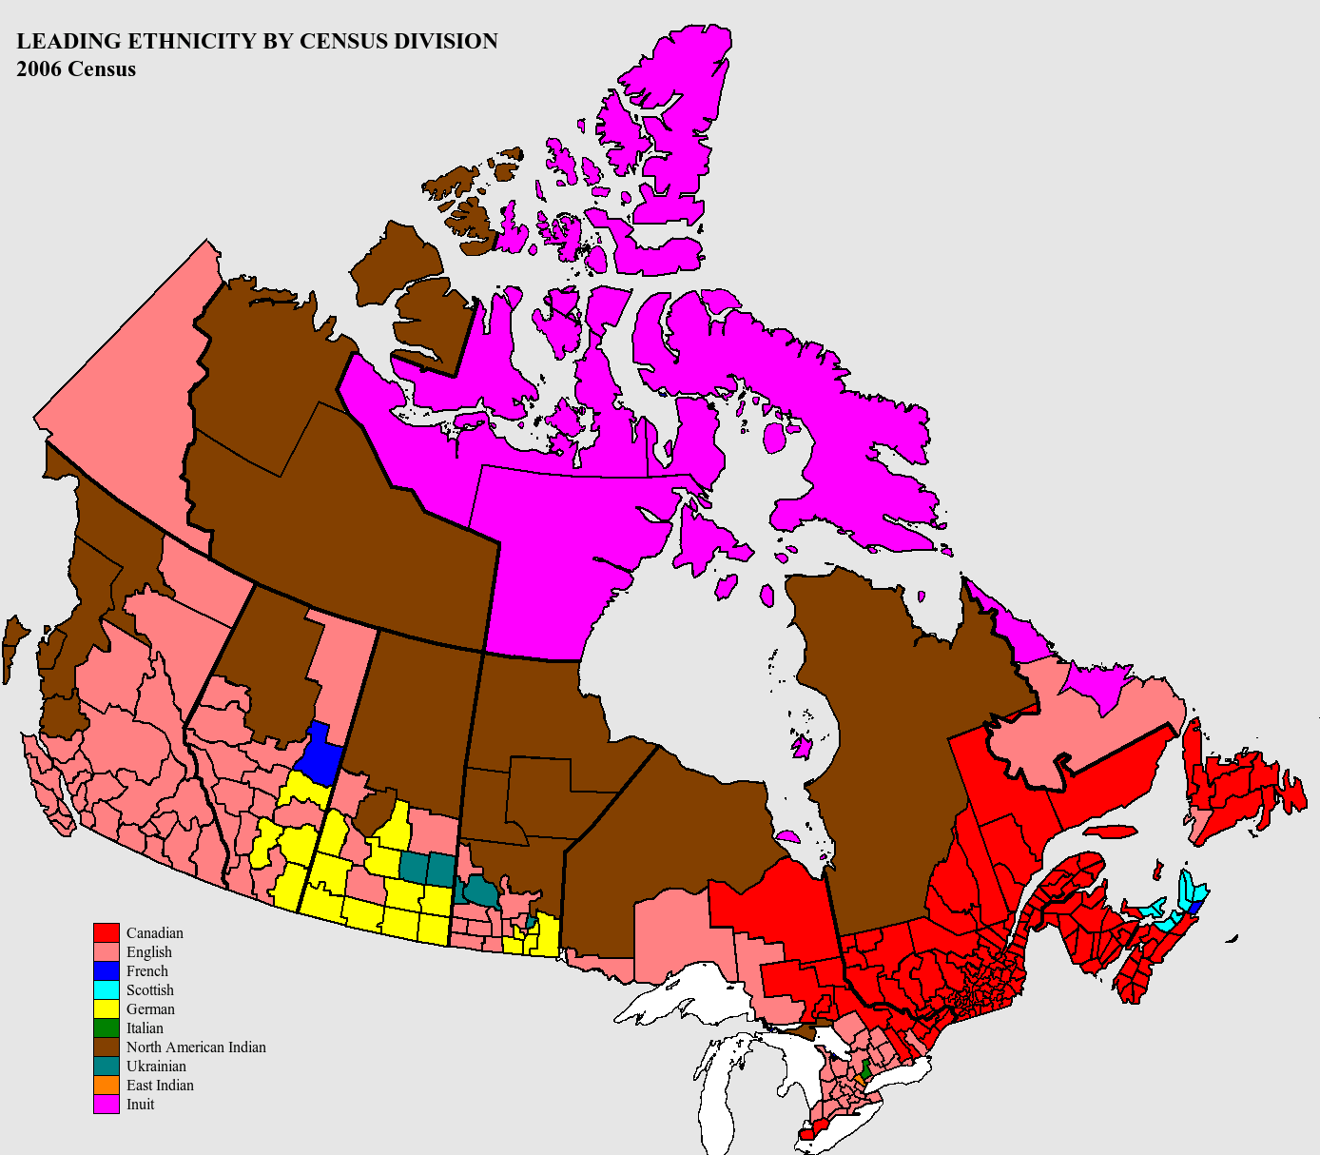
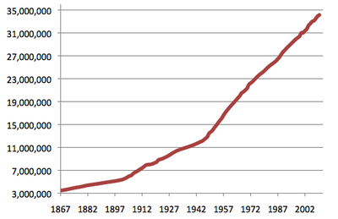
Canada has a population of approximately 30 million people

Slide 4
There are 2 official languages - English and Français

Slide 5
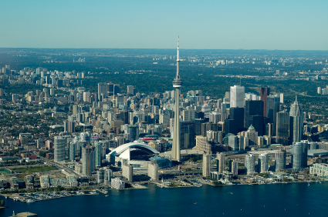
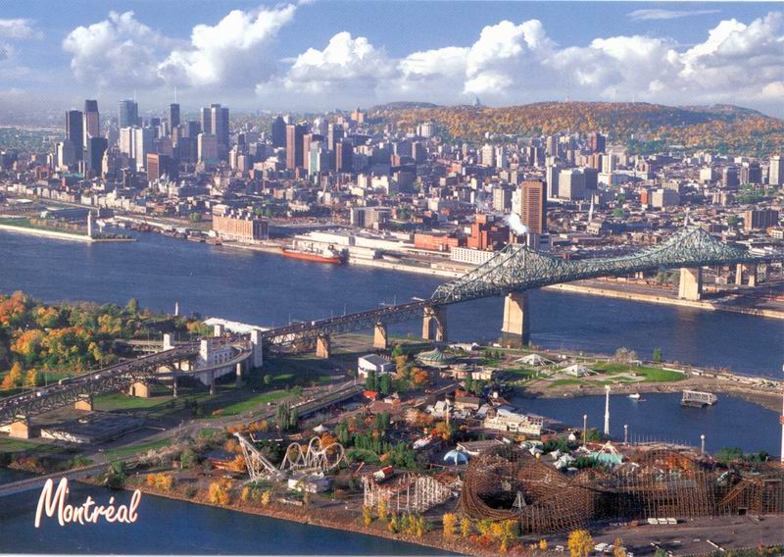
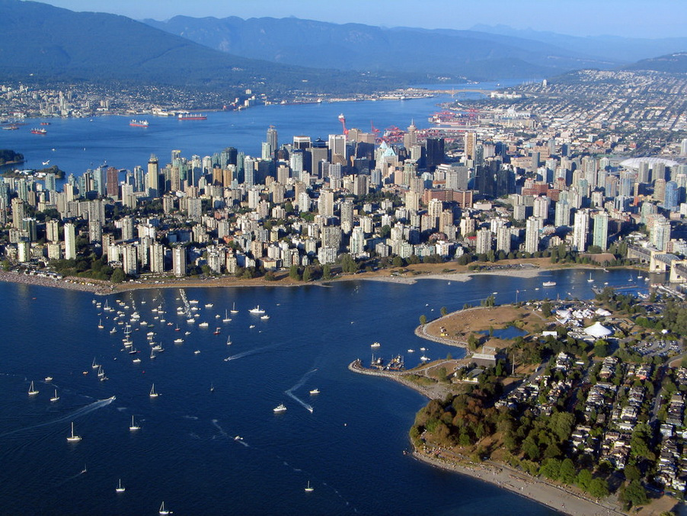
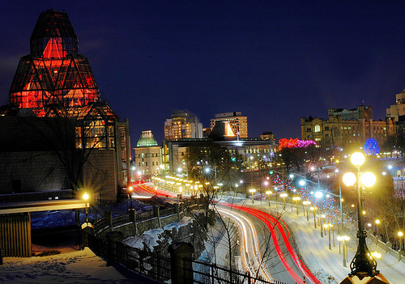
Canada's largest city is Toronto, followed by Montreal, Vancouver and Ottawa. The country's capital is Ottawa

Slide 6
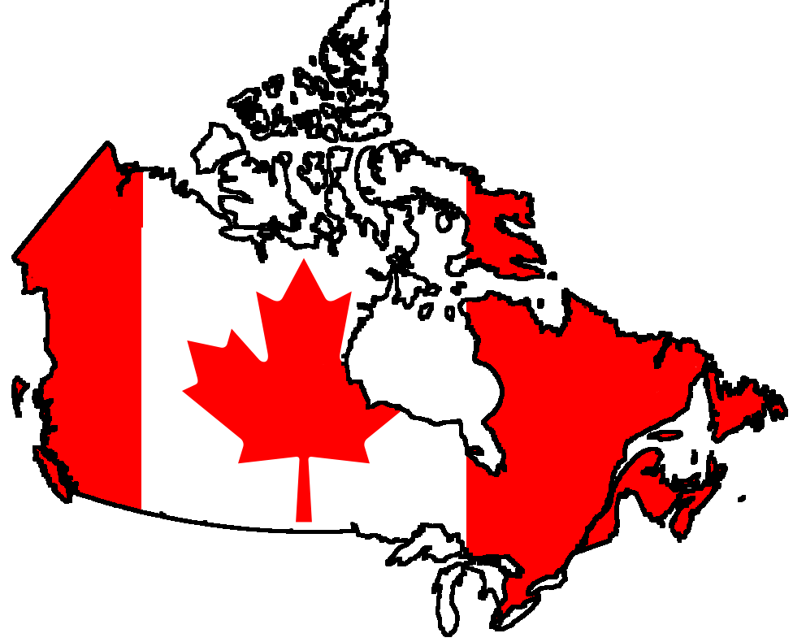
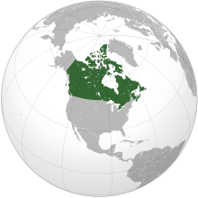
Ten million square kms of land make up the country, making it the second largest country (next to Russia).

Slide 7
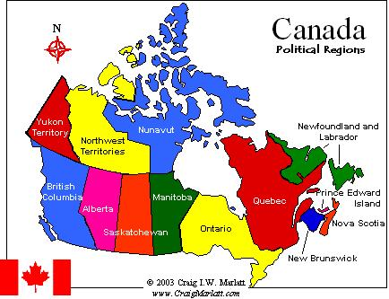
Canada is divided up into 10 Provinces and 3 territories

Slide 8
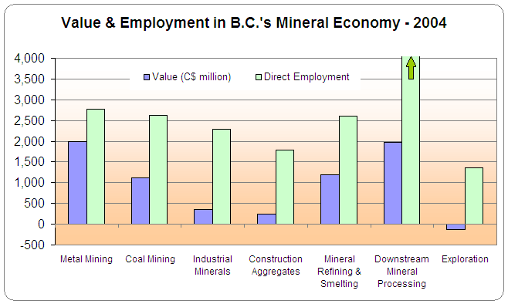
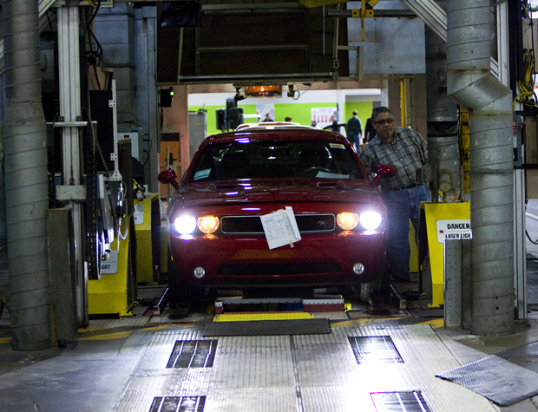
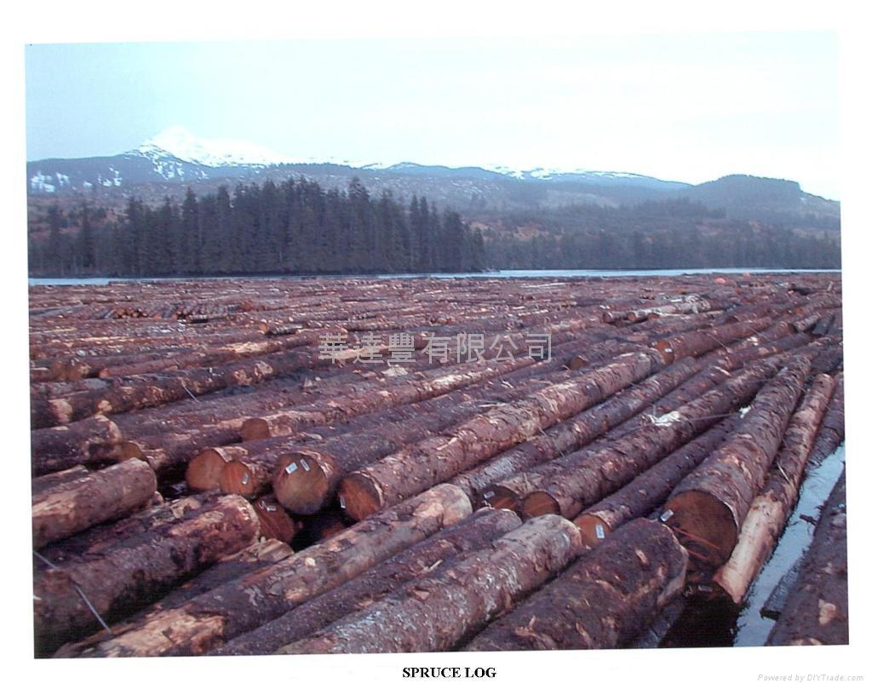
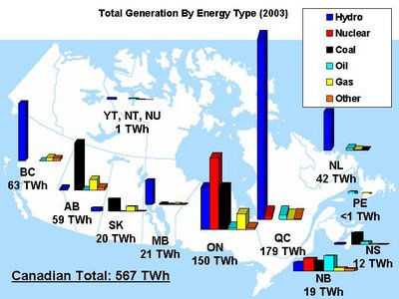
Canada's leading exports are automobile vehicles and parts, machinery and equipment, high-technology products, oil, natural gas, metals, and forest and farm products. Leading industries include automobile manufacturing, pulp and paper, iron and steel work, machinery and equipment manufacturing, mining, extraction of fossil fuels, forestry and agriculture.

Slide 9
The Maple leaf and beaver are Canada's national symbols .

Slide 10
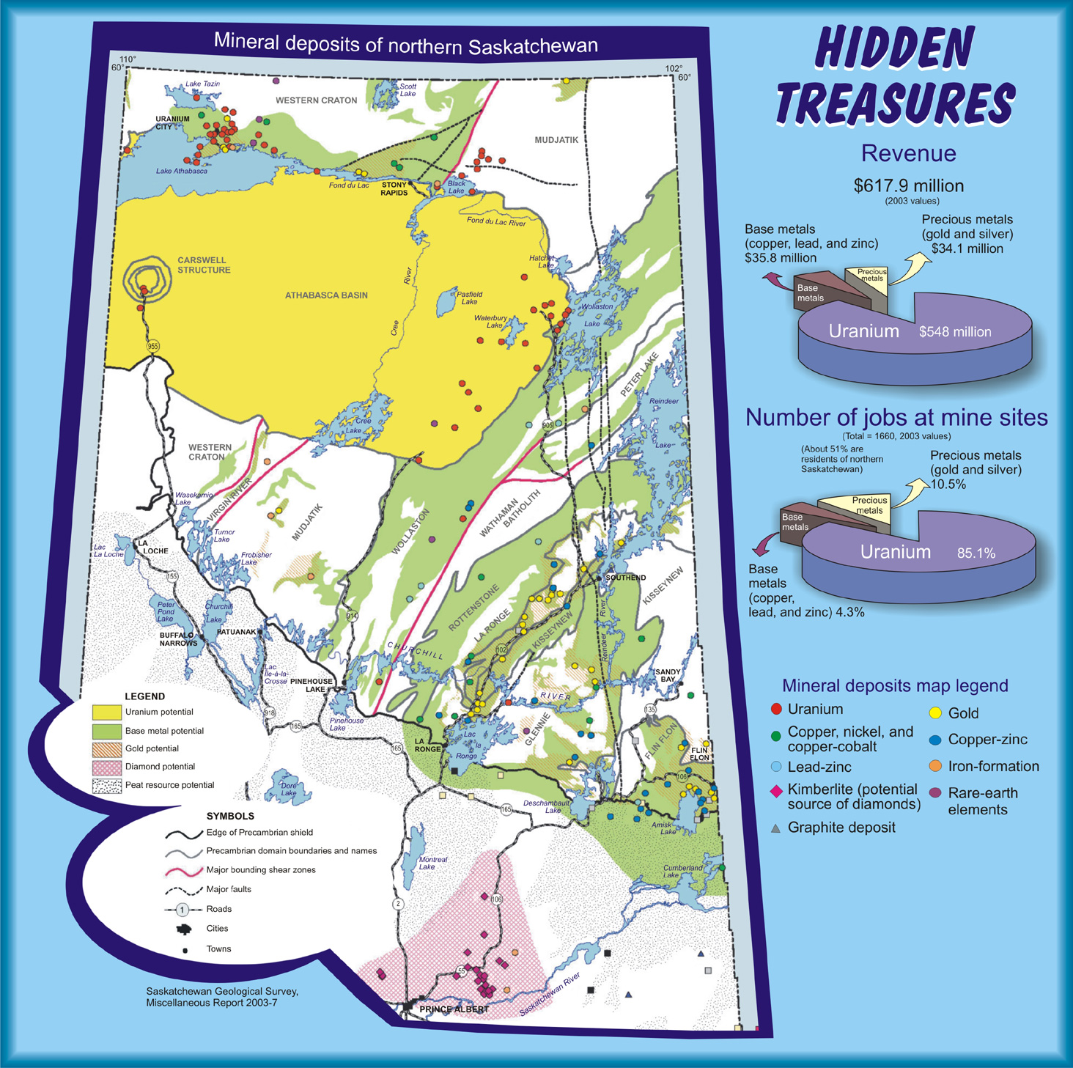
Canada's main natural resources are natural gas, oil, gold, coal, copper, iron ore, nickel, potash, uranium and zinc, wood and water.

Slide 11
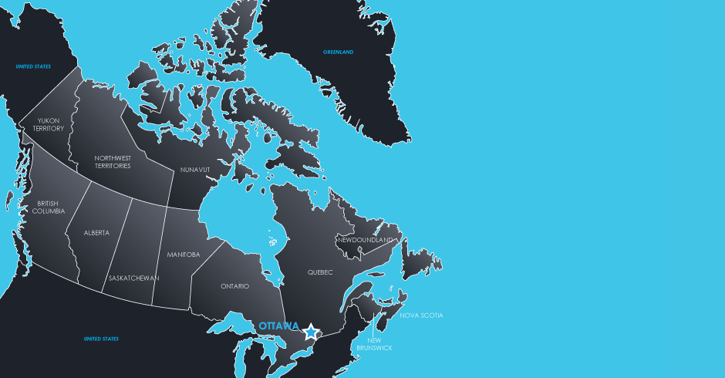
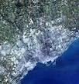
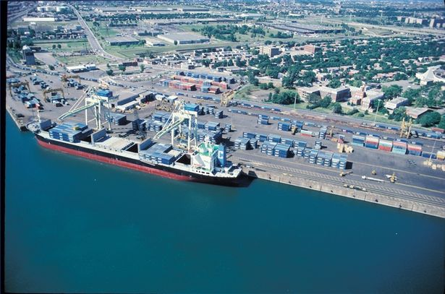
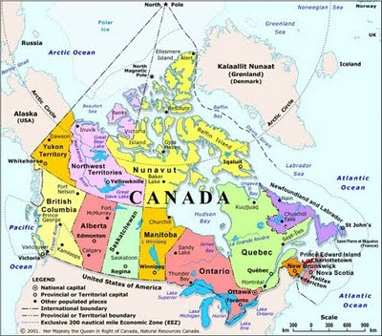
The coastline (243,792 km) is the longest in the world.

Slide 12
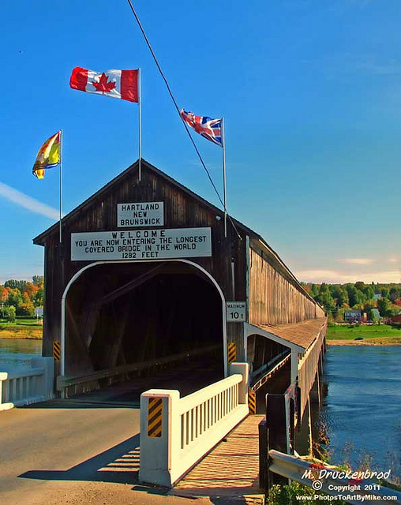
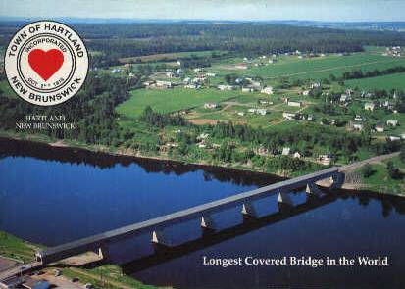
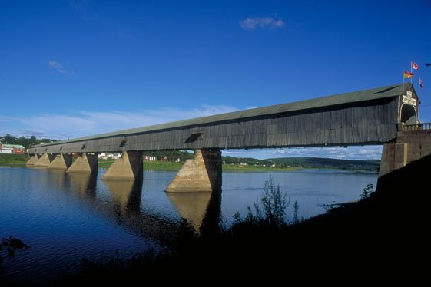
Canada has the longest covered bridge in the world. It's located in Hartland,
New Brunswick and is 1,282 feet long.

Slide 13
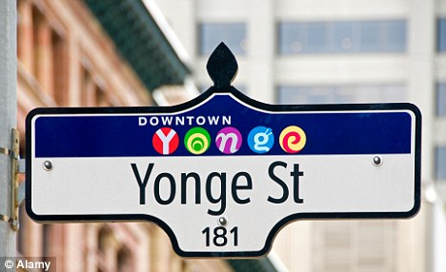
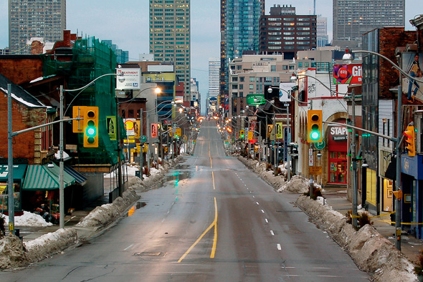
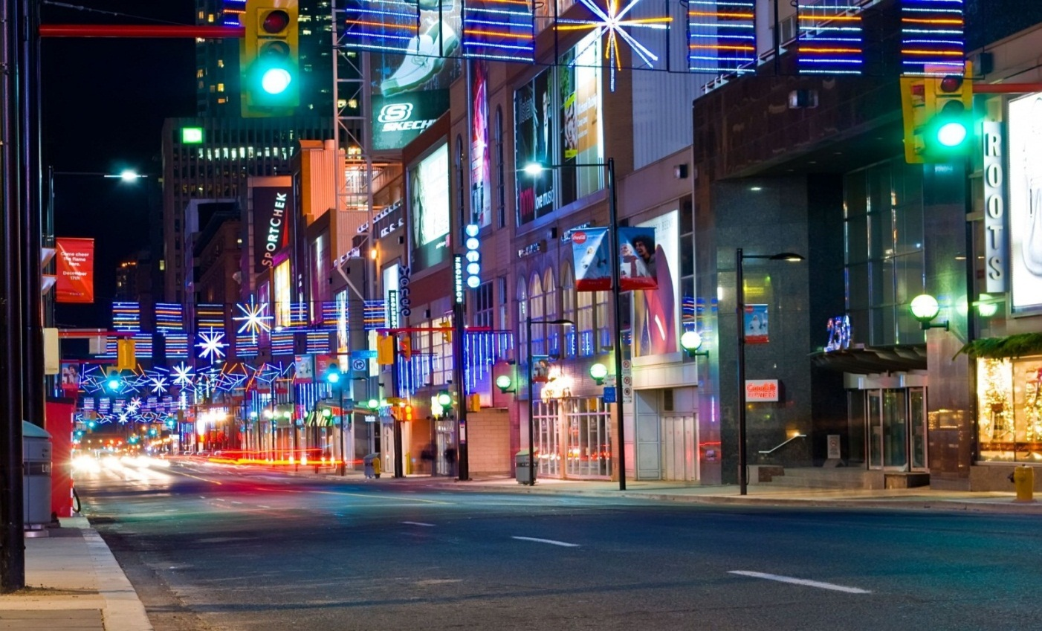
The longest street in the world is Yonge Street (in Toronto), and is 1,900.5 kilometers long.

Slide 14
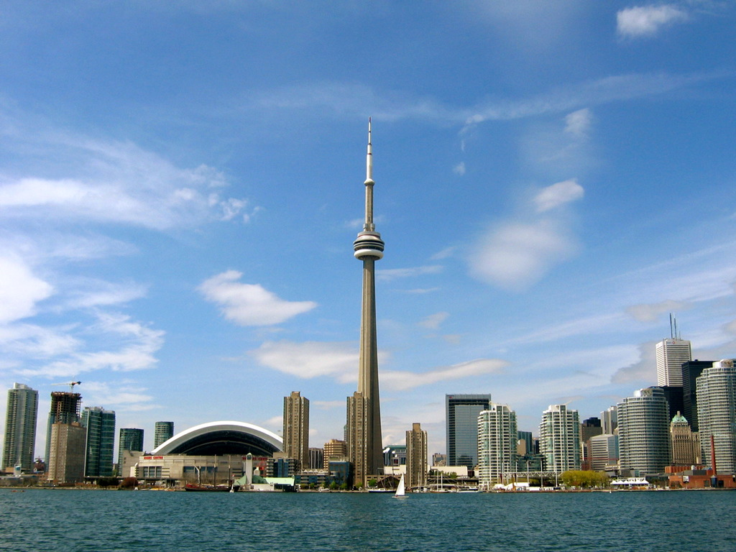
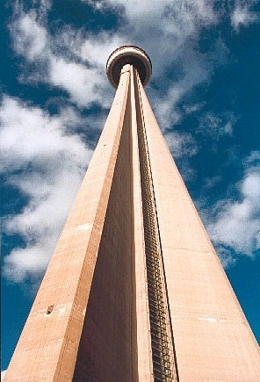
Also in Toronto, the CN Tower stands at 1,815 feet and 5 inches high. It was completed in 1975 and is the second tallest freestanding structure in the world.

Slide 15
Anyone in Canada can send a letter to a member of Parliament (while it's in session) without paying postage.

Slide 16
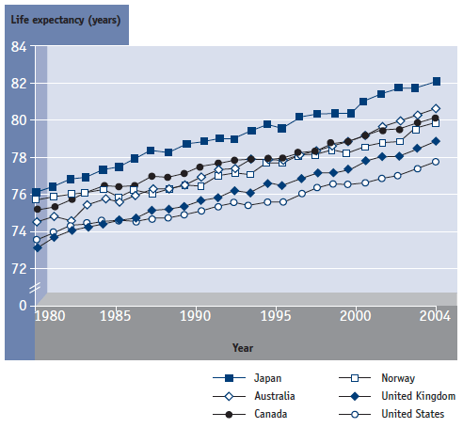
Life expectancy in Canada is 75.6 years for males and 81.7 years for females (which ranks in the world's longest)

Slide 17
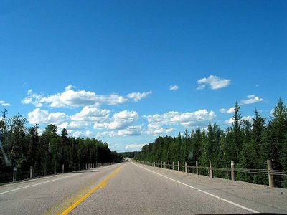
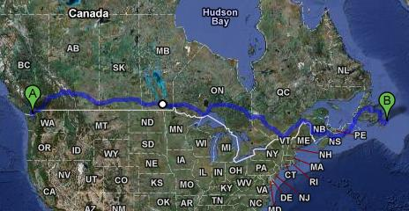
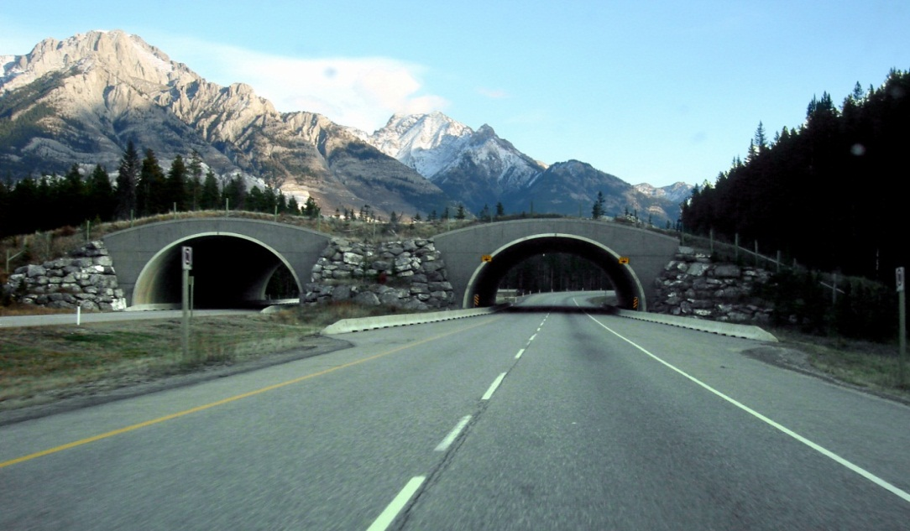
Canada has the longest national highway in the world - the Trans-Canada highway
(7,821 kilometers)

Slide 18
Ice hockey and lacrosse are Canada's national sports.

Slide 19
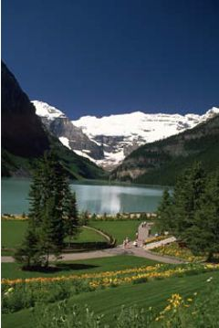
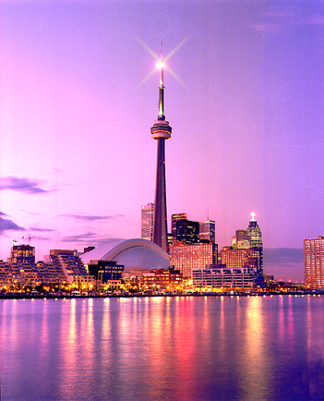
Canada is such a gorgeous country, it's no wonder that it is one of the top ten most popular places for international tourists. Tourism has become a major industry. In the early 1990s almost 40 million tourists visited Canada a year.

Slide 20
Canada Quiz
Answer the following questions:
What is the population of Canada?
What is the official language of Canada?
What is the largest city of the country?
What is the capital city of Canada?
What are the national symbols?
What are Canada’s leading exports?
What are Canada’s main natural resources?
What is Hartland famous for?
What is the longest street in the world?
What are Canada’s national sports?

